Slide 1
UNIT – I
Introduction to Computers
Computer Systems, Computing Environments, Computer Languages, Creating and running programs, Program Development, algorithms and flowcharts, Number systems-Binary, Decimal, Hexadecimal and Conversions, storing integers and real numbers.
Introduction to C Language
Background, C Programs, Identifiers, Types, Variables, Constants, Input / Output, Operators(Arithmetic, relational, logical, bitwise etc.), Expressions,
Precedence and Associativity, Expression Evaluation, Type conversions, Statements- Selection Statements(making decisions) – if and switch statements, Repetition statements ( loops)-while, for, do-while statements, Loop examples, other statements related to looping – break, continue, goto, Simple C Program examples

Slide 2
Chapter 1
Introduction to Computers

Slide 3
Computer systems
A Computer is an electronic device which performs arithmetical (all complex problems can be broken down into), logical operations (true or false). It can store data, retrieve information. It is speedy, versatile and accurate.
Parts of computers:
1.Input devices(keyboard)
2. Output devices (printer, monitor)
3.Central processing unit(CPU)
4.Storage devices(temporary storage)
5.Auxilliary devices(disk, parmanent storage)

Slide 4

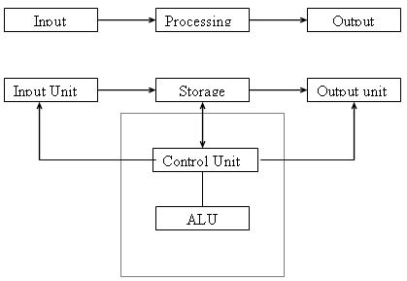
BLOCK DIAGRAM OF COMPUTER

Slide 5
Computer systems
Parts of computers:
1.Input devices(keyboard)
2. Output devices (printer, monitor)
3.Central processing unit(CPU)
a.Memory Unit
i.Storage devices(temporary storage)
ii.Auxilliary devices(disk, parmanent storage)
b.Control Unit
c.Arithmetical and logical unit

Slide 6
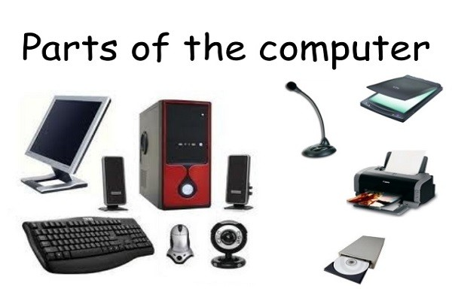

Slide 7
Unit 1
Input Devices
An input device feeds data to the computer system for processing.
Human beings too have many input devices, likewise computers too have several input devices. Few example input devices are Keyboard, Mouse, Scanner,Digital Camera , Camcorder, Gamepad, Joystick, Steering wheel, Mic, Barcode Reader,
Webcam,Pen / Stylus,Touch Screen,Biometrics (Thumb impression / Face detection), magnetic tape (both as input and output device inline with the notebook to a student)

Slide 8
Computing Environments
A computer is a system made of two major components: hardware (hard to touch and feel) and software (soft to touch and feel intelligence of a person).

Slide 9
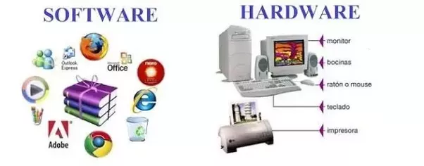
Basic Hardware & software

Slide 10
Hardware and Software
System software consists of programs that manages to perform its task
Hardware is physical equipment which we can feel and touch
Computer hardware has CPU which executes instructions such has arithmetical calculations ,data movement operations, logical operations etc
Primary storage stores programs and data temporarily during processing time
5. Secondary memory where data stores permanently ready to use next time

Slide 11
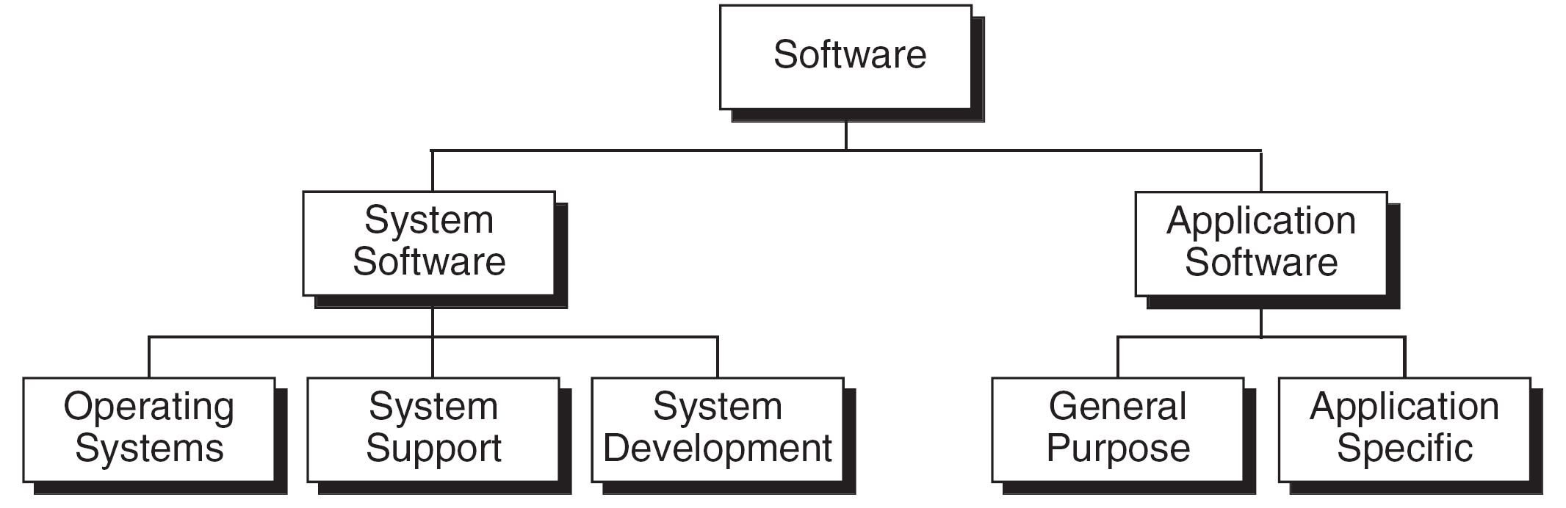
Types of Software

Slide 12
System software manages computer resources , acts as interface between hardware and users
Operating systems: acts as an interface between interface and application software
System Development software:
It includes languague translators that converts program in to machine languague for execution
Application Software:
They can solve variety of user computing problems
Eg: DBMS,CAD

Slide 13
Computing Environments
Computing Environment is a collection of computers /machines, software, and networks that support the processing and exchange of electronic information meant to support various types of computing solutions.
Personal Computing Environment
Time-Sharing Environment
Client/Server Environment
Distributed Computing

Slide 14
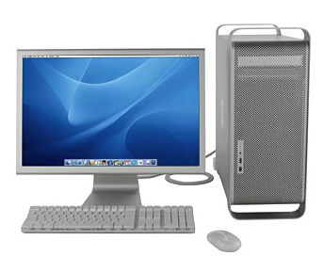
1971-Marican E Hoff- Intel-combined basic elements of CPU in to Microprocessor-on chip Intel
Personal Computing Environment

Slide 15
Time Sharing Environment:
1.Large companies often use this environment for employees sharing work
2.Many users are connected to one or more computers
3.Terminals are share output devices & storage devices
4.Central computer:
-to control shared devices
-it manages shared data & storage
Disadvantages:
The system response will be slow towards users

Slide 16
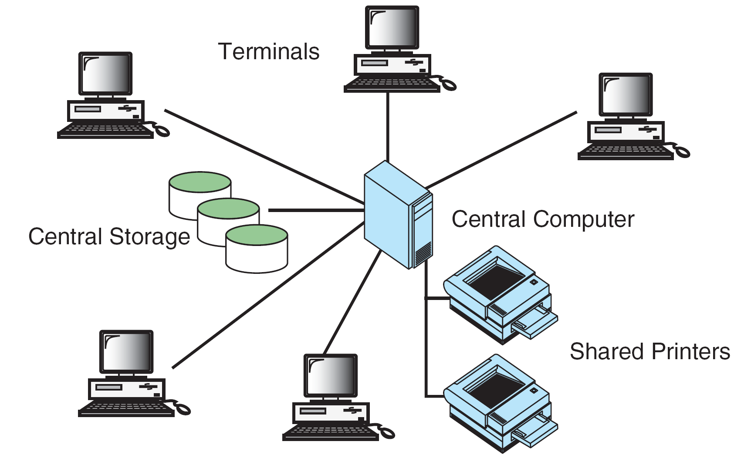
Time-sharing Environment

Slide 17
Client /Server Environment:
1. It splits the computer functions between central computer and users computers:
Users/workstation-Client
Central computer –server
2. The response time& monitor display is faster hence the users are more productive
Advantages:
Browsing is fast… response for any search online is faster
Eg: google

Slide 18
The Client/Server Environment

Slide 19
Distributed Computing:
It provides seemless integration of computing functions between different servers and different clients
The internet provides connectivity to different servers throughout the world
Eg: e-bay
Advantages:
It is realiable, scalable,highly available networks

Slide 20
Distributed Computing

Slide 21
Computer Languages
To write a program for a computer, we must use a computer language. Over the years computer languages have evolved from machine language to natural languages.
Machine Languages
Symbolic Languages
High-Level Languages

Slide 22
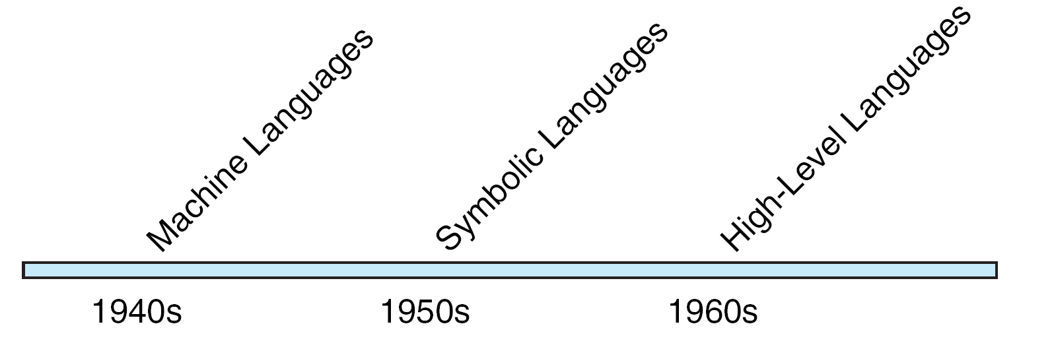
Computer Languague Evolution

Slide 23
Machine Languague:
In past only programming languague available was machine lang made up of stream of bits 0’s & 1’s
Internal circuits of computer was made up of circuits ,switches,transistors
It has only two states:
ON-1’s
OFF- 0’s

Slide 24
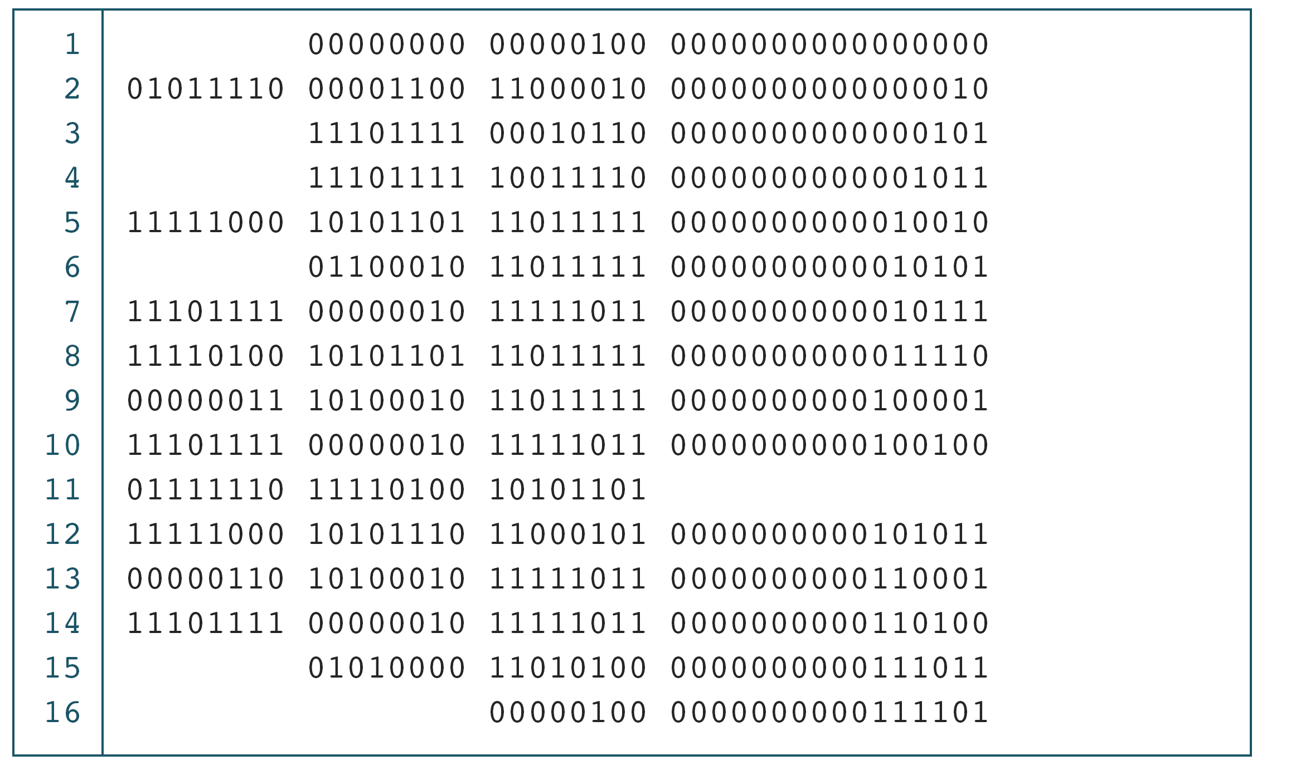
Program in machine languague

Slide 25
Assembly languague:
Hopper-1950- special computer program converting m/c lang using symbols(Assembler)
Using Mnemonics
Eg:
Load a1;
Mov a1,a2,b;
Using labels controlling the program
Label a1;

Slide 26
High Level Languague:
To improve program efficiency rather than writing individual coded symbolic lang.
This lang is portable to many different computers allowing the programmer to concentrate on developing application
First high level langugue:
FORTAN(john backus)
COBOL(hopper )

Slide 27
Example
Low level (processor dependent)
Machine code, assembler
High level: structured, procedural
Fortran, C, Pascal…
High level: object oriented
C++, Java, C#, Perl, Objective-C…
Virtual machines
Java, C#…
Scripting
Perl, Python, JavaScript…

